Slide 1
Audio Mood Visualizer
(Automatic Speech Emotion Visualization Through Avatars)

Slide 2
Omnia Ahmed
Team Members
Alaa Salah
Amany Elsayed
Nourhan Adel
Mai Adel
Nour Elhoda Ahmed
Supervised by:
Dr. Hanan Hindy
A.L. Yomna Ahmed

Slide 3
Table of contents
01
02
03
04
Introduction
Problem definition & motivavtion
Objectives
Related Works
05
06
System architecture
Datasets
07
08
Phases description
Experiments & results
09
10
Demo
Conclusion & Future work

Slide 4
“When dealing with people,
remember you are not dealing with
creatures of logic, but creatures of
emotions”.
Dale Carnegie

Slide 5
Introduction

Slide 6

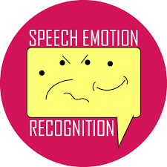
Introduction
Speech is a complex signal that carries a wealth of information about the speakers, their language, the content of their message, and their emotional state. It is the most natural way for humans to express themselves, and when we are forced to use other forms of communication such as text messages or emails, we become acutely aware of its importance.
Speech emotion recognition is the identification of emotional states. So, we used it in our application that visualizes the emotions of the speaking person through the generation of a selected avatar that reflects the emotion detected from speech.

Slide 7
Problem Definition & Motivation

Slide 8
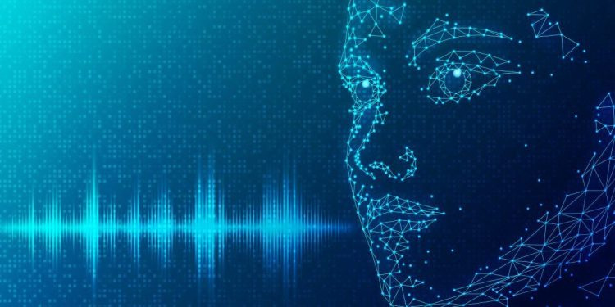
Problem Definition & Motivation
Our aim in this project is to develop a system capable of accurately detecting and classifying human emotions from audio signals. Emotions are inherently subjective and ambiguous, making it difficult to define clear boundaries between different emotional states.

Slide 9
Problem Definition & Motivation
Our main motivation was to train an efficient model that detects emotions from voice and visualizes these emotions through an avatar. Such an application can be utilized in many fields:
Medical field: can help people who have social phobias to communicate easily with others.
Games: Deliver a virtual reflection of a player’s emotions while protecting their privacy.
Customer service: can aid the call center workers.
E-learning and virtual meetings: help teachers to detect the emotional state of the students throughout the sessions.
Supports privacy: You can use a photo that isn't yours or by using a default avatar.

Slide 10
Objectives

Slide 11
Objectives
Apply recent advances in speech emotion recognition research.
Visualize the recognized emotions (Happy, Sad, Fearful, Calm, Angry) through the generation of avatars with facial expressions that correspond to the detected emotion.
Create an application where the user could communicate with people and all his/her emotions are delivered to them through an avatar without needing to open the camera.
Experiment with additional features to further customize the avatars while preserving the identity of the original speaker.

Slide 12
Related Works

Slide 13
Paper | Model | Dataset | Evaluation (Accuracy)
Separable Transformer (SepTr) | Separable Transformers | CREMA-D ESC-50 Speech Commands | 70.47% 91.13% 98.51%
SER using Machine Learning | CNN | RAVDESS | 80%
SER using CNN and multi-head convolutional transformer | Convolutional Neural Networks and Multi-Head Convolutional Transformer | RAVDESS IEMOCAP | 82.31% 79.42%
SER Using Wav2vec 2.0 Embedding | Wav2vec 2.0 Embedding | RAVDESS IEMOCAP | 64.3% 71.6%

Slide 14
System Architecture

Slide 15
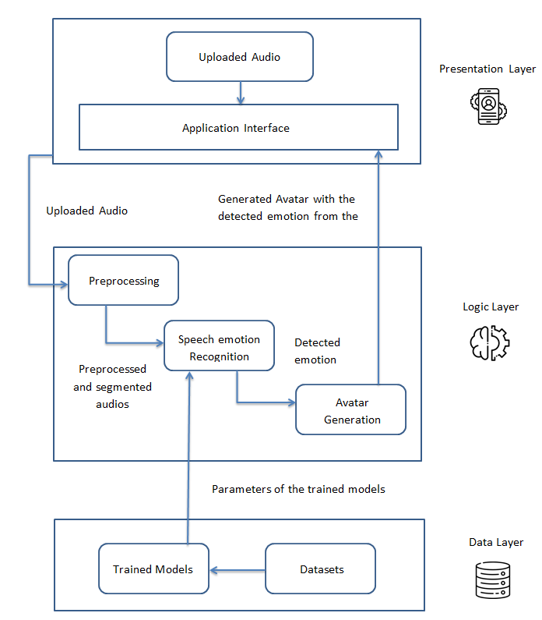

Slide 16
Datasets

Slide 17

)RAVDESS Dataset ( :
Full dataset of speech, contains audio and video. It contains :
1440 audio file recorded With 24 professional actors (12 female, 12 male).
Speech emotions include (calm, happy, sad, angry, fearful, surprise,
neutral and disgust) expressions.
Each expression is produced at two levels of emotional intensity
(normal, strong), with an additional neutral expression.
Dataset Sample
Training | Validation | Testing
1152 | 144 | 144

Slide 18
Phases Description

Slide 19
02
04
01
03
Preprocessing
Phases Description
Feature Extraction
Avatar Generation
Speech Emotion Recognition

Slide 20
1. Preprocessing
Extract waveforms from dataset
Divide data into train, validation, and test
Applying data augmentation on training through AWGN (Additive White Gaussian Noise)
Apply normalization on data to reduce training time
Audio without noise
Audio with noise

Slide 21
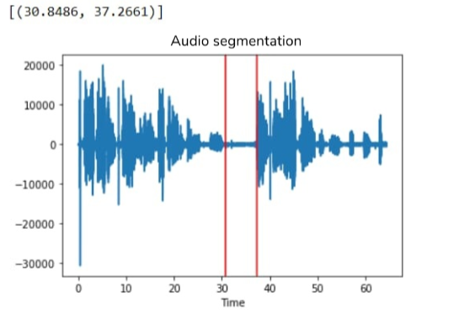
1. Preprocessing
Audio Segmentation :
As the dataset contains audios of one sentence, we applied segmentation so we could split the test audio (if it’s longer than one sentence) into sentences.
The audio is preprocessed before sending it to the speech emotion recognition module. We split audio into small audio segments according to silence. Then remove noise from audio. Then detect emotions from audios according to MFCC.

Slide 22
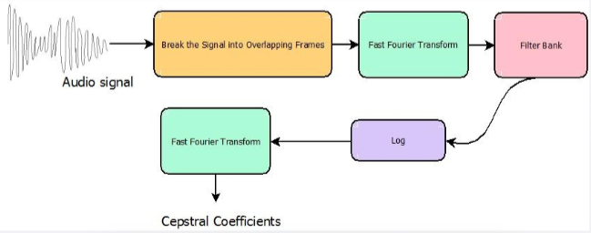
2. Feature Extraction
MFCCs was used for features extraction.
MFCCs are a set of coefficients that capture the spectral characteristics of an audio signal.

Slide 23
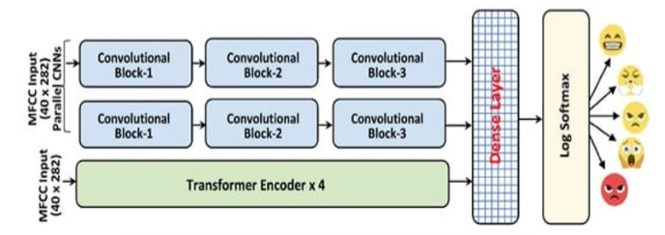
3. Speech Emotion Recognition
It contains two parallel CNN model and multi-head attention transformer encoder to recognize emotions in speech spectrograms from audio

Slide 24
3. Speech Emotion Recognition
Transformer block includes :-
number of transformer encoder layer=4.
Each transformer encoder layer contains:-
Self-attention heads (4).
Dropout(0.4).
Activation function(Relu).
Each convolution block includes :-
2D convolution layer.
Batch normalizes.
Activation function(Relu).
Max_pooling 2D.
Dropout(0.3).
Fully connected dense network and SoftMax activation function for emotion state prediction.

Slide 25

4. Avatar Generation
We created avatars by taking the emotions detected from the previous phase and created the suitable combinations of attributes such as : eyebrows, eyes, mouth, ....etc. to get the suitable emotional avatar.
Then we send these combinations to python_avatar library to generate the desired emotional avatar.
It has many attributes such as :
style, background_color, eyes.
top, eyebrows, nose, facial_hair,
hair_color, accessory, clothing,
clothing_color, mouth.

Slide 26


4. Avatar Generation
We created 2 copies of the emotional avatar :
- one with closed mouth
- one with opened mouth
, so that it would give the sense of speaking.
To create the video, all emotions detected in the audio are put in an array and displayed along with the audio.

Slide 27
Experiments & Results

Slide 28
Experiments & Results
1- LSTM:
Preprocessing :
We used 8 classes instead of 4 classes.
Trials :
Architecture:
1st Trial | 2nd Trial
Added a convolutional layer Followed by Batch Normalization layer. | Increased number of LSTM layers from 2 to 3.
76% | 89%

Slide 29
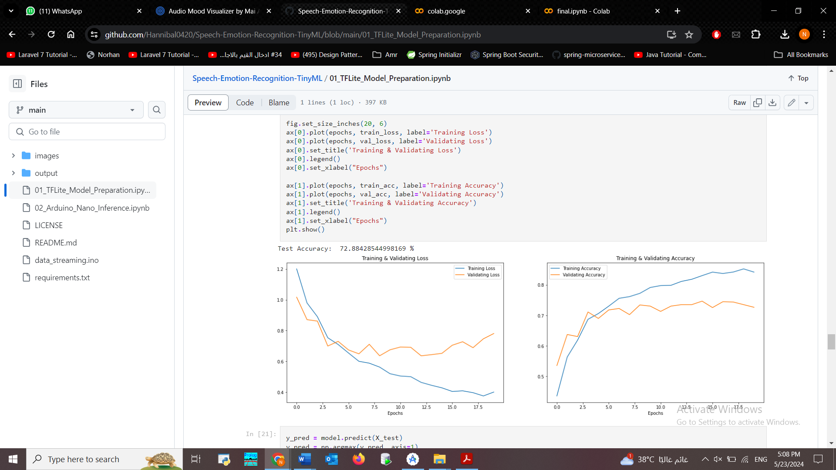
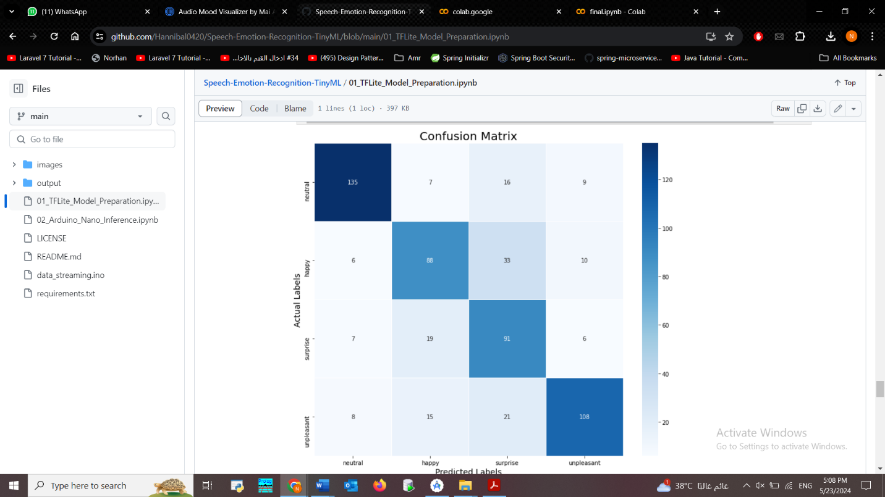
Experiments & Results
Dataset : RAVDESS.
Number of epochs : 500.
We observed that the neutral and unpleasant emotions were the best emotions the model could predict.

Slide 30
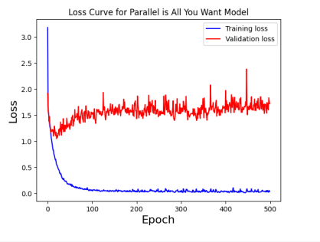
Experiments & Results
2- CNN & multi head transformer model :
Trials :
Feature Extraction :-
1st Trial | 2nd Trial
Mel-spectrogram. | MFCC(Mel-Frequency Cepstral Coefficients).
75% | 95%

Slide 31
Experiments & Results
Architecture :-
1st Trial | 2nd Trial | 3rd Trial | 4th Trial
In transformer encoder block: We changed the number of layers from 4 to 6. | In two convolution blocks : We changed Max_pooling to Average_pooling. | Used Transformer encoder only. | Used normalization layer instead of batch normalization
Accuracy 76%. | Accuracy 74%. | Accuracy 78% | Accuracy 82%

Slide 32
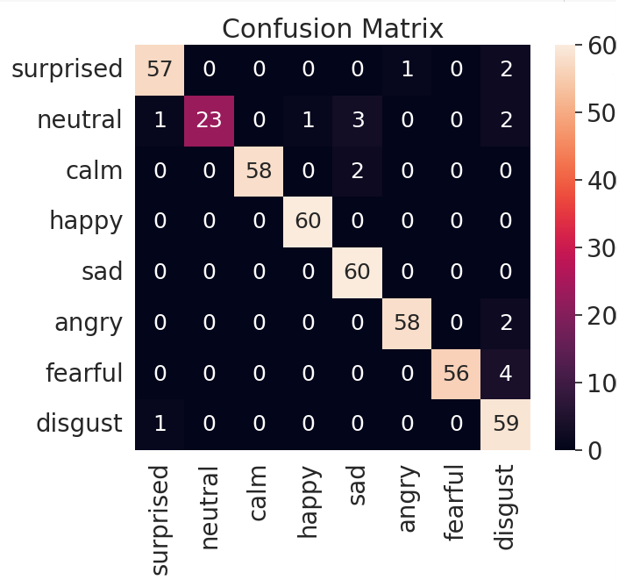
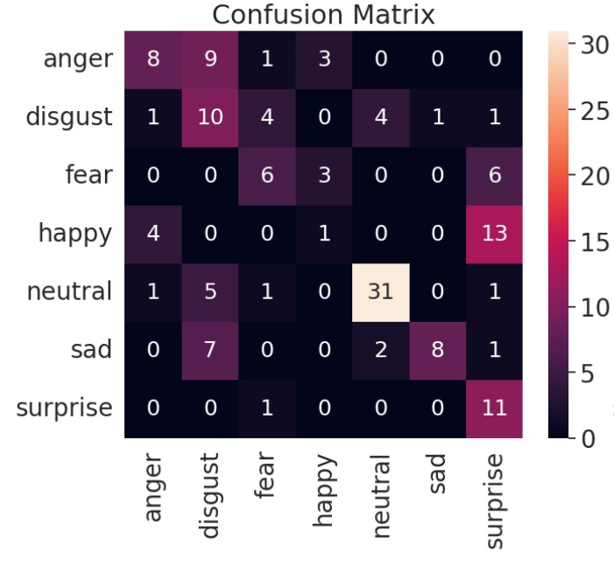
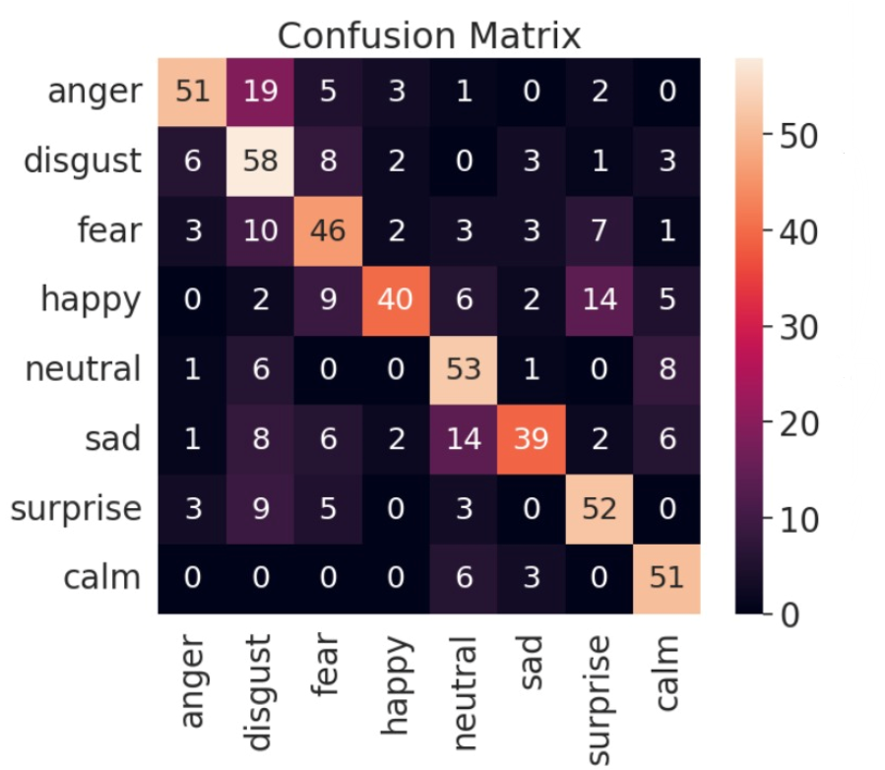
Experiments & Results
Datasets :-
1st Trial | 2nd Trial | 3rd Trial
RAVDESS | SAVEE | RAVDESS + SAVEE
Accuracy 95%. | Accuracy 62.5%. | Accuracy 72.7%.

Slide 33
Real-time

Slide 34
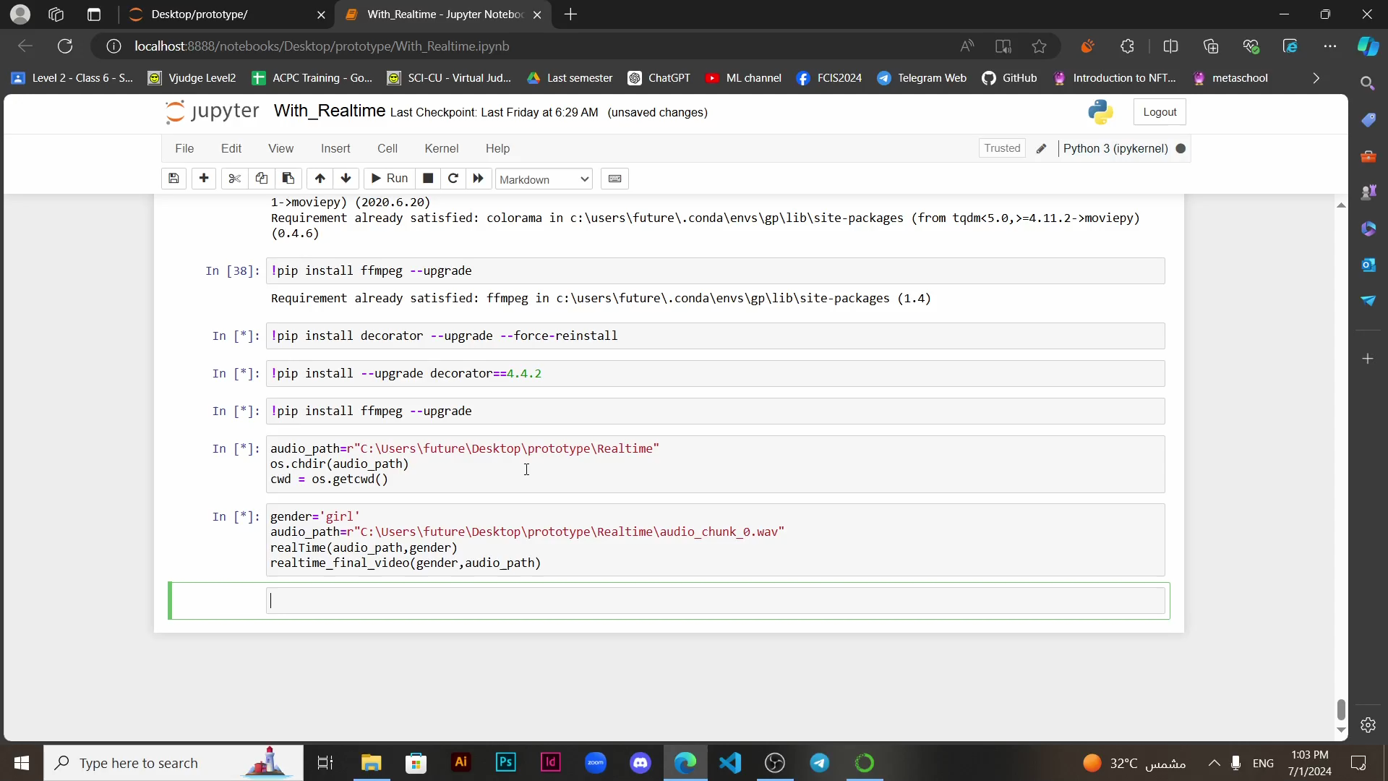
Real-time
In Realtime, Pyaudio library is used to record audio from a microphone. The recorded audio is saved to the device, then it is passed to our trained model so a small video is generated, and this video is showed up. This process is repeated every 10 seconds. You can stop recording through a keyboard interrupt. So, every 10 seconds you see a new emotional video to the words you have said 10 seconds later.

Slide 35
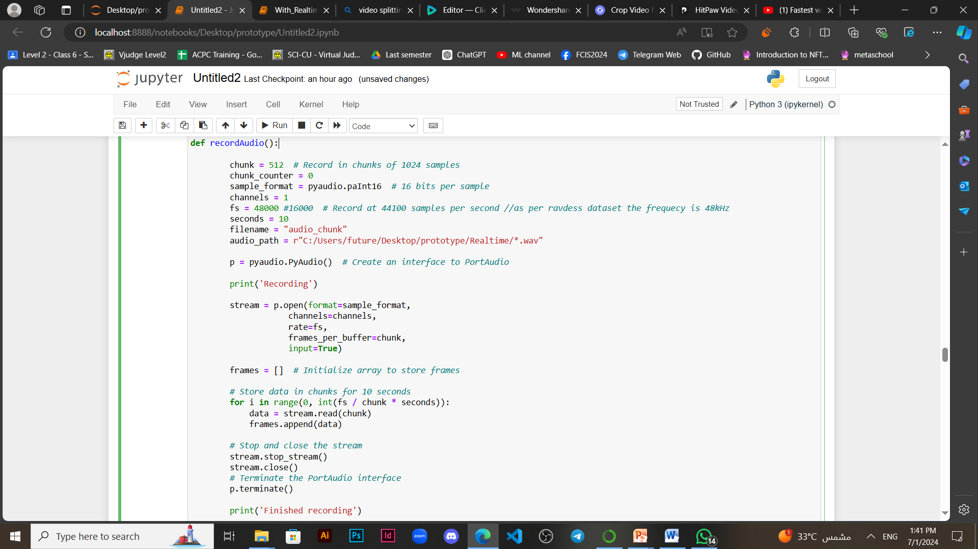
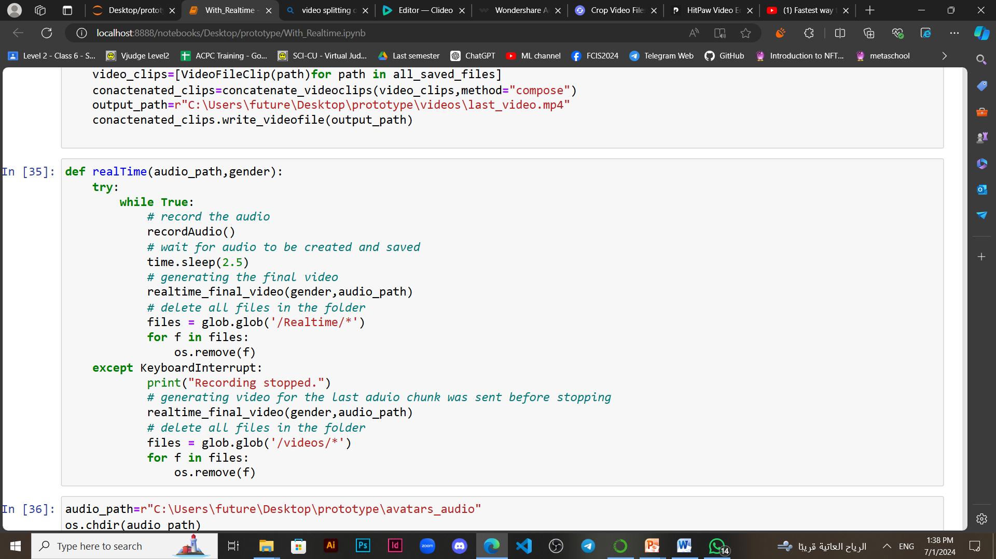
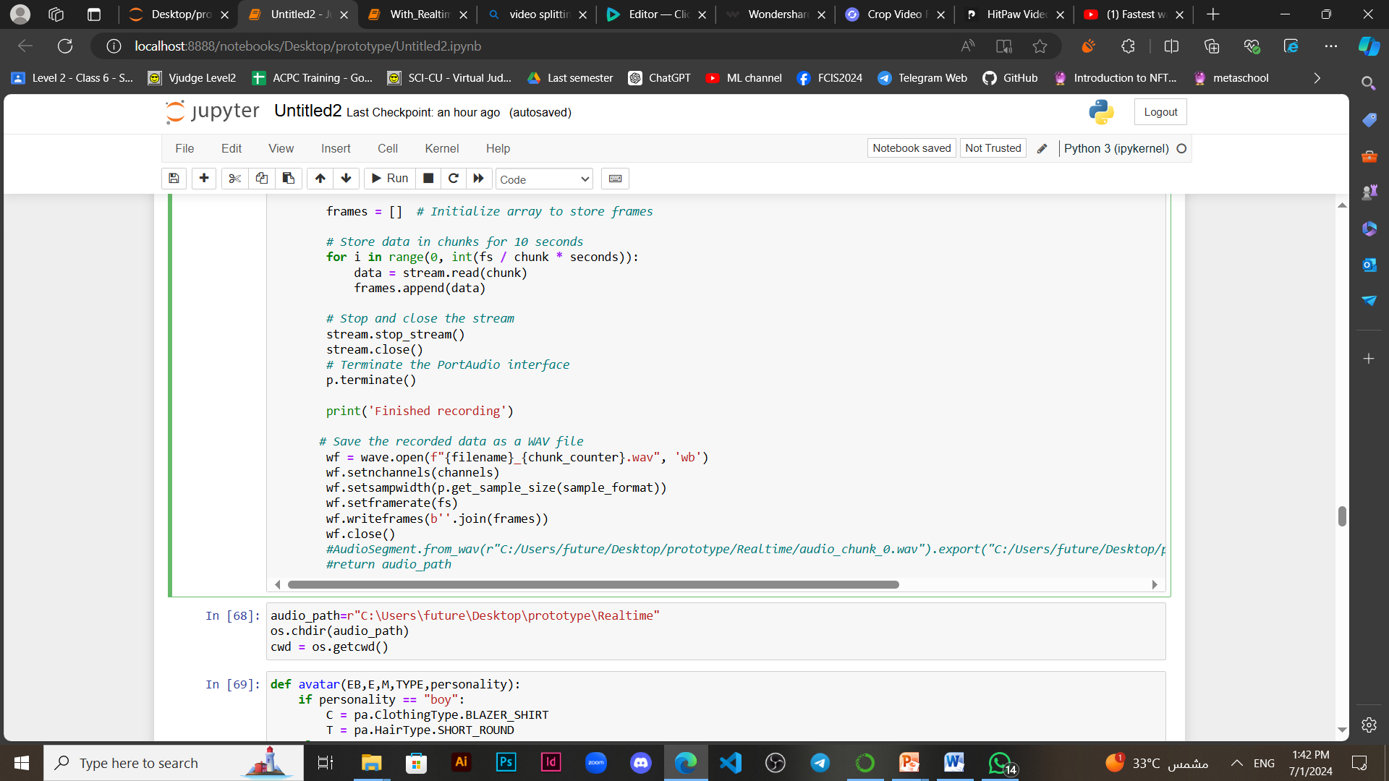
Real-time

Slide 36
Demo

Slide 37
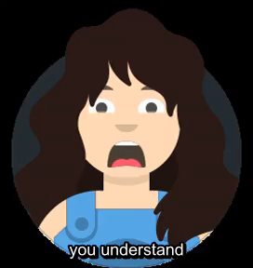

Demo
Female Demo
Male Demo

Slide 38


Demo
Female Demo
Male Demo

Slide 39
Conclusion & Future Work

Slide 40
Conclusion
In this project, our aim was to visualize emotions detected from speech using avatars. This is achieved by detecting emotions from speech using SER techniques and Avatar generation techniques.
For speech emotion recognition, we applied 2 models: CNN and Multi-Head Convolutional Transformer model and the LSTM model. We experimented with different configuration for both models and using many datasets such as RAVDESS , SAVEE , TESS and even a combination between RAVDESS and TESS. Eventually, the CNN and Multi-Head Convolutional Transformer model trained on the RAVDESS dataset was used as our main SER trained model as it achieved the best accuracy compared to the other combinations of models with different datasets.
We observed that the model best detects the distinct emotions of “angry” and “sad” and could not differentiate between “calm” and “neutral” emotions as they are close to each other in the voice tone.

Slide 41
Phase Type | Trial | Accuracy | Conclusion | Paper (SER with CNN and Multi-head Transformer)
Feature Extraction | Mel-spectrogram | 75% | Using MFCC as our main feature extraction technique. | Used MFCC to extract features from audio.
 | MFCC | 95%
Dataset | SAVEE | 62.5% | Using RAVDESS as our main dataset. | Used RAVADESS Dataset to train and test model .
 | RAVDESS + SAVEE | 72.5%
 | RAVDESS | 95%
Pooling Layer | average_pooling Layer | 74% | Using Max_Pooling Layer. | Used Max_Pooling Layer.
 | Max_pooling Layer | 95%

Slide 42
Phase Type | Trial | Accuracy | Conclusion | Paper (SER with CNN and Multi-head Transformer)
Number of Layers in Transformer Encoder | 6 Layers | 76% | Using 4 Layers Transformer Encoder | Used 4 Layers Transformer Encoder.
 | 4 Layers | 95%
Layer used in CNN Block | normalization layer | 82% | Using batch normalization layer in CNN block. | Used batch normalization layer in CNN block.
 | batch normalization | 95%
Architecture | Transformer Encoder Only | 78% | Using CNN and Transformer Encode in Architecture. | Used CNN and Transformer Encoder in Architecture.
 | CNN and Transformer Encoder | 95%

Slide 43
Future Work
Possible venues for future work include:
1. Avatar personalization while preserving the identity of the original speaker and the addition of lip-syncing using deep fake technologies without the reliance on camera footage.
2. Visualizing the emotions of multiple users at the same time
3. Improving the accuracy of detection of the calm and the neutral emotions of better differentiation between them.

Slide 44
Thank you

